Slide 1


Emotion Detection Through Facial Expression
Faculty: Dr. Charu Pathak
Ayush
Kuka Bharat

Slide 2
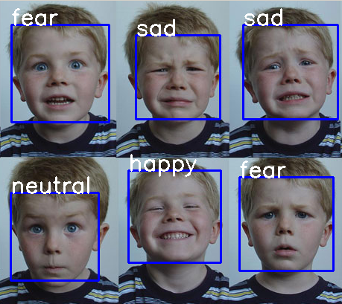
Emotion Detection
Emotion detection is the process of identifying and interpreting human emotions based on various inputs, such as facial expressions, voice tone, body language, or physiological signals. The goal is to use technology and algorithms to recognize emotional states like happiness, sadness, anger, fear, surprise, and more.

Slide 3
Why Detection Through Facial Expression
Facial expressions are a major channel for emotion recognition because they are one of the most direct and universally understood forms of non-verbal communication.
Immediate and Involuntary: Facial expressions are often spontaneous reactions to emotions, giving real-time insights into how a person is feeling. Even without verbal cues, emotions like happiness, anger, or surprise can be easily identified just by looking at someone’s face. | Universality: Certain facial expressions, such as those for basic emotions like happiness, sadness, anger, fear, surprise, and disgust, are universally recognized across different cultures. This makes facial expressions a reliable indicator for emotion detection systems.
Rich Information: The face has numerous muscles that allow for subtle expressions and micro-expressions. These fine movements provide detailed information about not just primary emotions but also mixed or hidden emotions. | Non-verbal Context: In many situations where verbal communication is limited or not possible (e.g., during virtual meetings, in medical settings, or with non-verbal individuals), facial expressions become the primary method of understanding emotions.

Slide 4
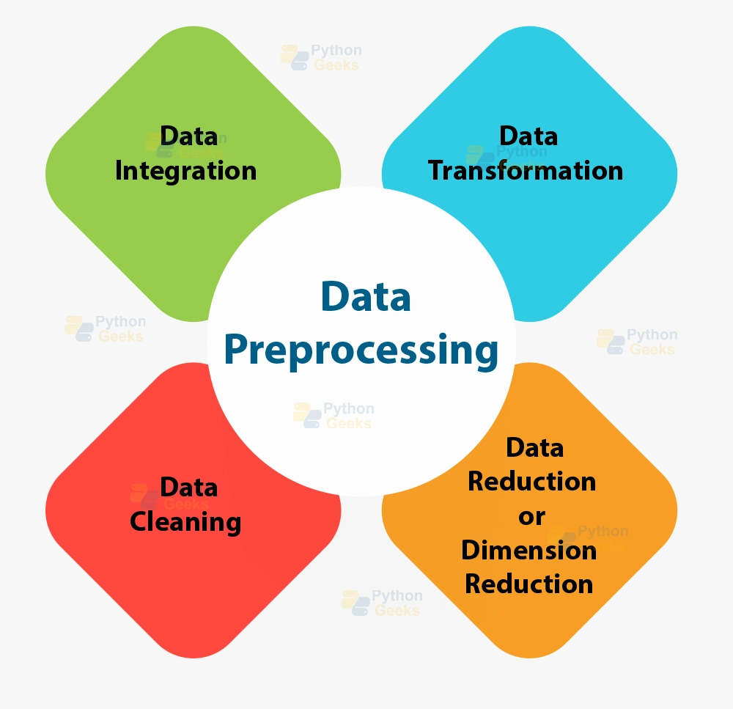
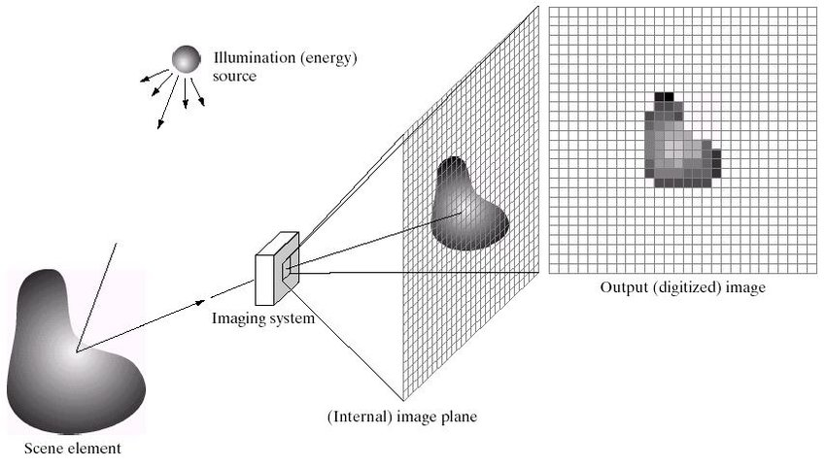
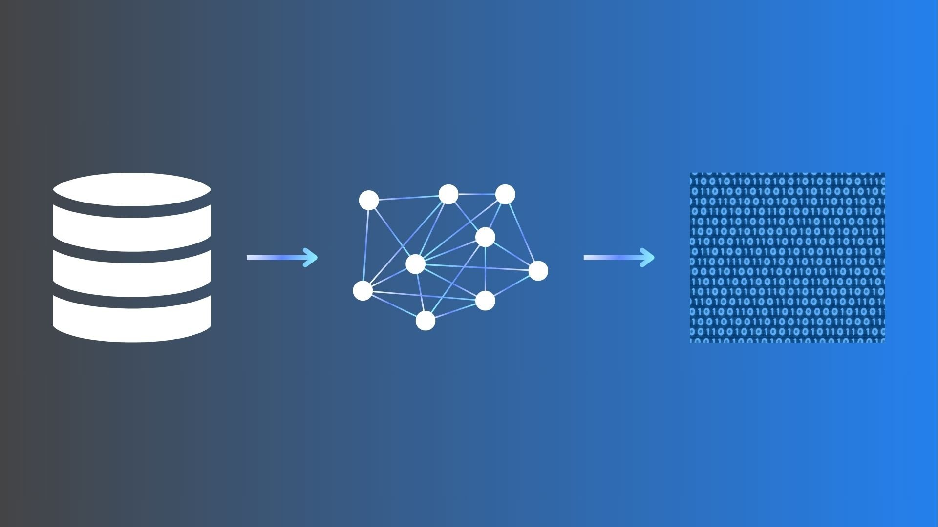
How It Works
Image Acquisition Preprocessing Feature extraction
Classification

Slide 5
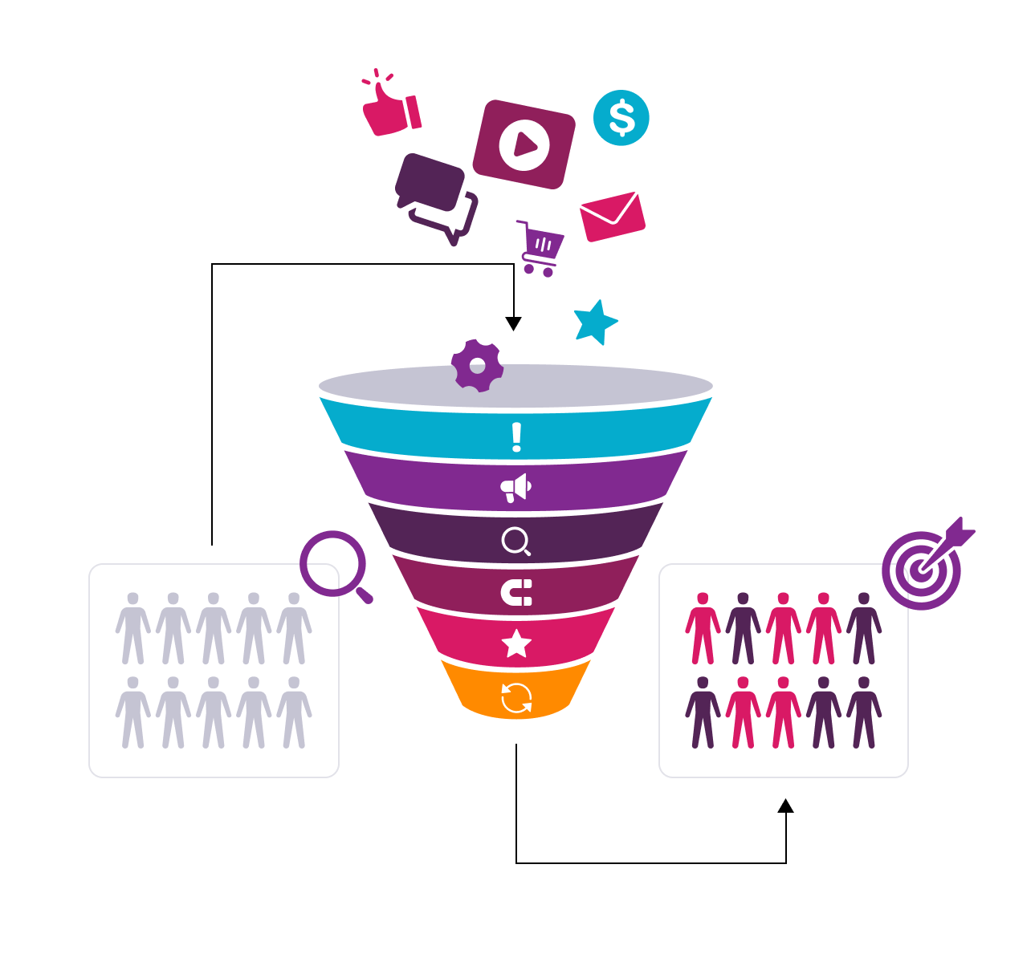
Data Collection
Collect a large dataset of images or videos of people displaying different facial expressions. We have used Kaggle for finding dataset for model Training.
We have dataset of 3 emotions Sad(757), Happy(1006), Angry(515).
Link:

Slide 6

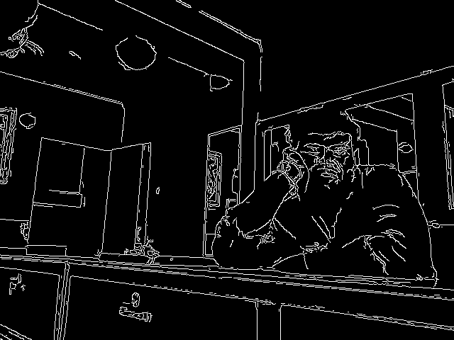
OpenCV Library
Open source Computer Vision library is a popular library used for computer vision task such as image processing, object detection, real time video processing.
Capture Image
Edge Detected Gray Scale image
(Canny edge detection algorithm)

Slide 7

Application
Healthcare
Mental Health Monitoring: Emotion detection helps in tracking emotional well-being and detecting early signs of stress, anxiety, or depression. By monitoring patients’ facial expressions, it can provide real-time feedback for mental health interventions.
Therapeutic Tools: Used in virtual therapy sessions to gauge a patient’s emotional state, ensuring more effective communication between therapist and patient.

Slide 8
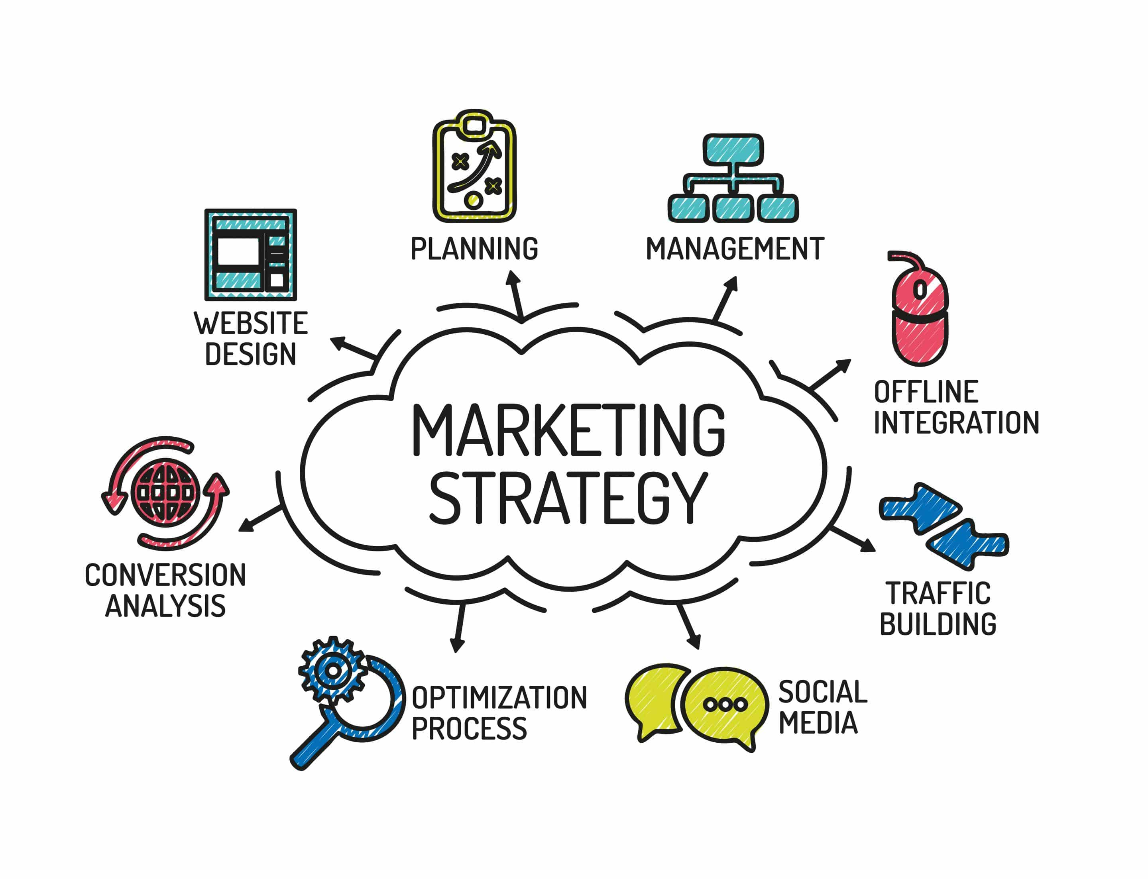

Customer Experience and Marketing
Emotion-Based Feedback: Marketers can use emotion detection during product testing or focus groups to gauge real-time reactions to products, advertisements, or services, allowing them to refine their strategies based on emotional responses.
Retail Experience: Stores may use emotion detection to analyze customers' feelings about products, in-store experiences, or customer service interactions, allowing for tailored engagement.

Slide 9
Conclusion

Slide 10

“Q&A”
"Thank you for your attention! Do you have any questions?“
"Feel free to ask any questions!"

